Slide 1

Pivotal Cloud Foundary

Slide 2
Agenda
PCF Introduction
PaaS
PCF App Manager Console
CF Orgs, Spaces & Roles
CF Components
PCF Architecture
Metrics and Loggregator
CF CLI
Deploy Apps on PCF
Scaling
Env Variables
VCAP services
PCF Services

Slide 3
PCF Introduction
Cloud Foundry (CF) is an open source and has become the industry standard for deploying apps.
Cloud platforms let anyone deploy network apps or services and make them available to the world in a few minutes. When an app becomes popular, the cloud easily scales it to handle more traffic.
Pivotal cloud foundry is an implementation of CF standards and specs.
One can do lots of work using PCF such as deploy applications on pivotal cloud foundry, buildpacks, manifests, organizations, spaces, users, roles, domains, routes, services
With PCF we can know how to push applications to Cloud Foundry (various languages), services, user provided services, manifests, YAML, environment variables, autoconfiguration, logging and loggregator.

Slide 4
PCF Introduction
Key aspects of PCF
Pivotal Cloud platforms, enabling you to focus exclusively on your applications and data without worrying about underlying infrastructure.
Cloud native apps can be deployed on your own computing infrastructure or on any IaaS platform (AWS, Vsphere, etc ..)
Cloud Foundry is ideal for anyone interested in removing the cost and complexity of configuring infrastructure for their apps.
Developers can deploy their apps to Pivotal Cloud Foundry using their existing tools and with zero modification to their code.
The platform’s openness and extensibility prevent its users from being locked into a single framework, set of app services, or cloud.

Slide 5
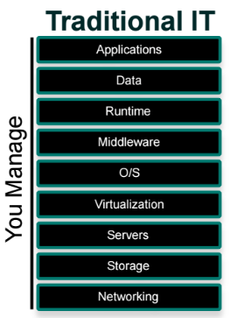
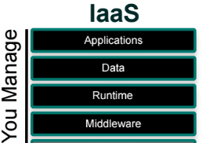

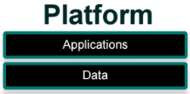
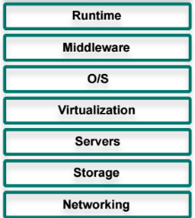

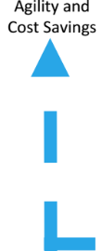
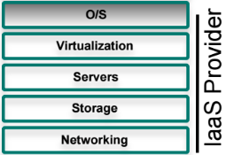
What is PaaS

Slide 6
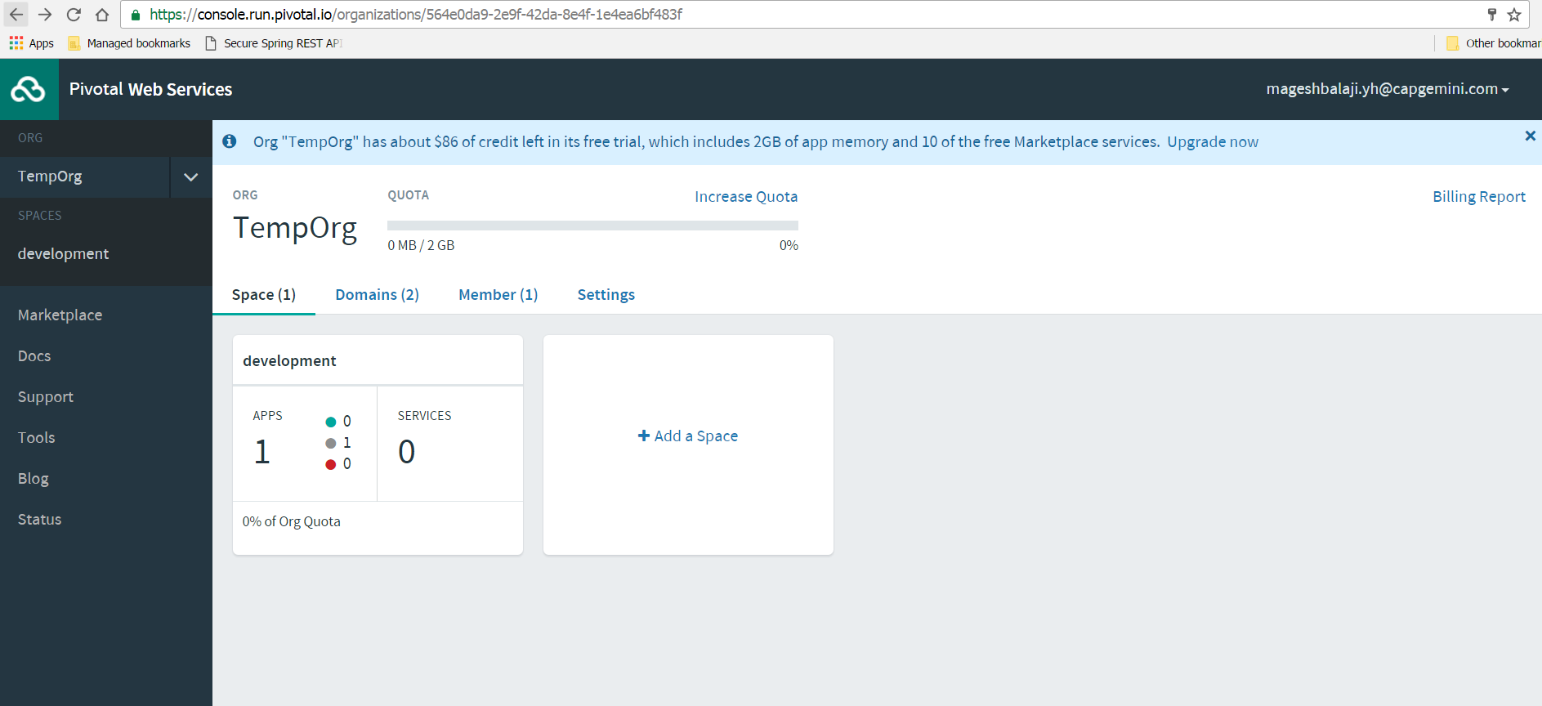
Apps Manager Console

Slide 7




CF Orgs, Space & Roles
CF uses a role-based access control (RBAC) system to grant Cloud Foundry users permissions appropriate to their role within an org or a space.
Orgs
An org is a development account that an individual or multiple collaborators can own and use. All collaborators access an org with user accounts. Collaborators in an org share a resource quota plan, applications, services availability, and custom domains.
Spaces
Every application and service is scoped to a space. Each org contains at least one space. A space provides users with access to a shared location for application development, deployment, and maintenance.
User Accounts
A user account represents an individual person within the context of a CF installation. A user can have different roles in different spaces within an org, governing what level and type of access they have within that space.
Roles &Permissions
A user can have one or more roles. The combination of these roles defines the user’s overall permissions in the org and within specific spaces in that org.

Slide 8
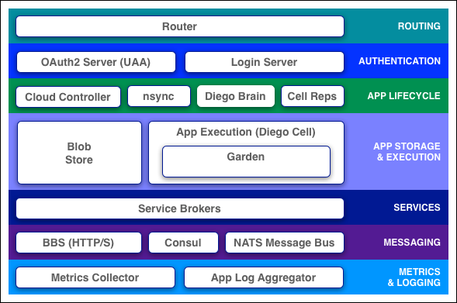
Cloud Foundry Components

Slide 9
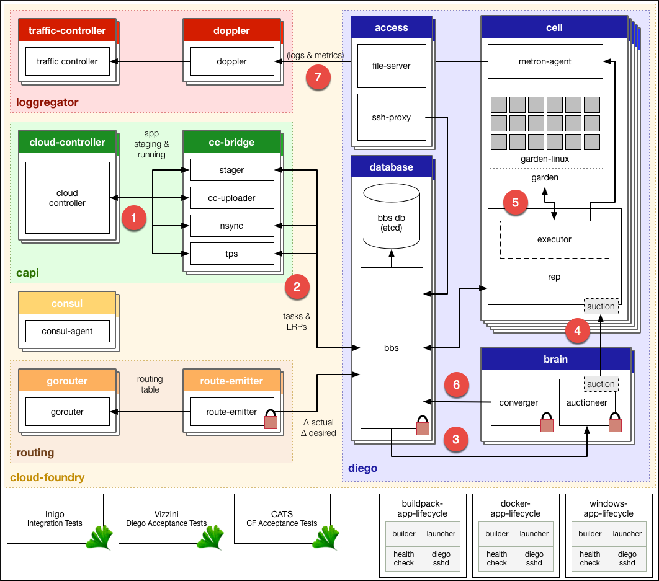
Diego Architecture

Slide 10
Diego Architecture
The Cloud Controller passes requests to stage and run applications to the Cloud Controller Bridge (CC-Bridge).
The CC-Bridge translates staging and running requests into Tasks and Long Running Processes(LRPs), then submits these to the Bulletin Board System (BBS) through an API over HTTP.
The BBS submits the Tasks and LRPs to the Auctioneer part of the Diego Brain.
The Auctioneer distributes these Tasks and LRPs to Cells through an Auction. The Diego Brain communicates with Diego Cells using SSL/TLS protocol.
Once the Auctioneer assigns a Task or LRP to a Cell, an in-process Executor creates a Garden container in the Cell. The Task or LRP runs in the container.
The BBS tracks desired LRPs, running LRP instances, and in-flight Tasks. It also periodically analyzes this information and corrects discrepancies to ensure consistency between ActualLRP and DesiredLRP counts.
The Metron Agent, part of the Cell, forwards application logs, errors, and metrics to the Cloud Foundry Loggregator. For more information, see the Application Logging in Cloud Foundry topic.

Slide 11
Metrics and Logging
Loggregator (log aggregator)
Loggregator is the next generation system for aggregating and streaming logs and metrics from all of the user apps and system components in an Elastic Runtime deployment.
The Loggregator system streams application logs to developers for many purposes.
You can configure Elastic Runtime to forward log data from components and apps to an external aggregator service instead of routing it to the Loggregator Firehose.
Use cases of Loggregator :
App developers can tail their application logs or dump the recent logs from the CF CLI, or stream these to a third party log archive and analysis service.
Operators and administrators can access the Loggregator Firehose, the combined stream of logs from all apps, plus metrics data from CF components.
Operators can deploy ‘nozzles’ to the Firehose. A nozzle is a component that listens to the Firehose for specified events and metrics and streams this data to external services.

Slide 12
CF CLI commands
Cloud Foundry Command Line Interface (cf CLI), a tool you use to deploy and manage your applications.
Name
cf - A command line tool to interact with Cloud Foundry
Usage
cf [global options] command [arguments…] [command options]
Use cf config to set the language. To set the language with cf config, use the syntax:
E.g.
cf config --locale YOUR_LANGUAGE
Use cf login to log in to Elastic Runtime.
E.g.
cf login [-a API_URL] [-u USERNAME] [-p PASSWORD] [-o ORG] [-s SPACE]
Commands for Listing Users:
E.g.
cf org-users
cf space-users

Slide 13
CF CLI Commands
The cf push command pushes a new app or syncs changes to an existing app.
Creating app my-awesome-app in org example-org
E.g. cf push my-awesome-app -b https://github.com/cloudfoundry/java-buildpack.git
To view available services from the PCF market place, use
E.g. cf marketplace
The cf help command lists the cf CLI commands and a brief description of each.
E.g. cf delete –h
List down apps
E.g. cf apps
To know the status of the app
E.g. cf app APP_NAME

Slide 14
CF CLI Commands
Commands for Managing Roles
E.g.
cf set-org-role (cf set-org-role huey@example.com example-org OrgManager)
cf unset-org-role
cf set-space-role
cf unset-space-role
Setting env variable
E.g.
cf set-env APP_NAME ENV_VAR_NAME ENV_VAR_VALUE
Command to Logout
E.g.
cf logout

Slide 15
App Deployment
Deployment Process
CF Push command to be used to push an cloud-native app into PCF.
Deploy an app to PCF by running a cf push command from the Cloud Foundry Command Line Interface (cf CLI).
E.g. cf push my-app -b https://github.com/cloudfoundry/java-buildpack.git
The command does few operation at the background:
Uploads and stores app files
Examines and stores app metadata
Creates a “droplet” (the Cloud Foundry unit of execution) for the app
Selects an appropriate Diego cell or Droplet Execution Agent (DEA) to run the droplet
Starts the app
Notes:
Before you can push your app to Cloud Foundry you need to know:
The API endpoint for your Cloud Foundry instance. Also known as the target URL, this is the URL of the Cloud Controller in your Cloud Foundry instance.
Your username and password for your Cloud Foundry instance.
The organization and space where you want to deploy your app. A Cloud Foundry workspace is organized into organizations, and within them, spaces. As a Cloud Foundry user, you have access to one or more organizations and spaces.

Slide 16
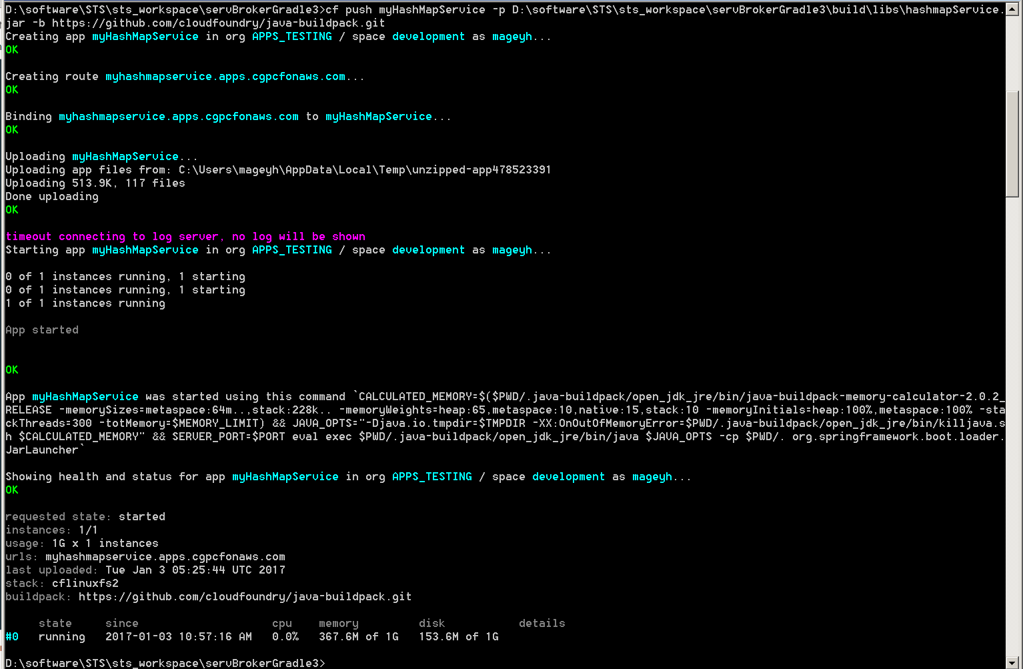
App Deployment
CF push through CLI
Notes:
Before you can push your app to Cloud Foundry you need to know:
The API endpoint for your Cloud Foundry instance. Also known as the target URL, this is the URL of the Cloud Controller in your Cloud Foundry instance.
Your username and password for your Cloud Foundry instance.
The organization and space where you want to deploy your app. A Cloud Foundry workspace is organized into organizations, and within them, spaces. As a Cloud Foundry user, you have access to one or more organizations and spaces.

Slide 17
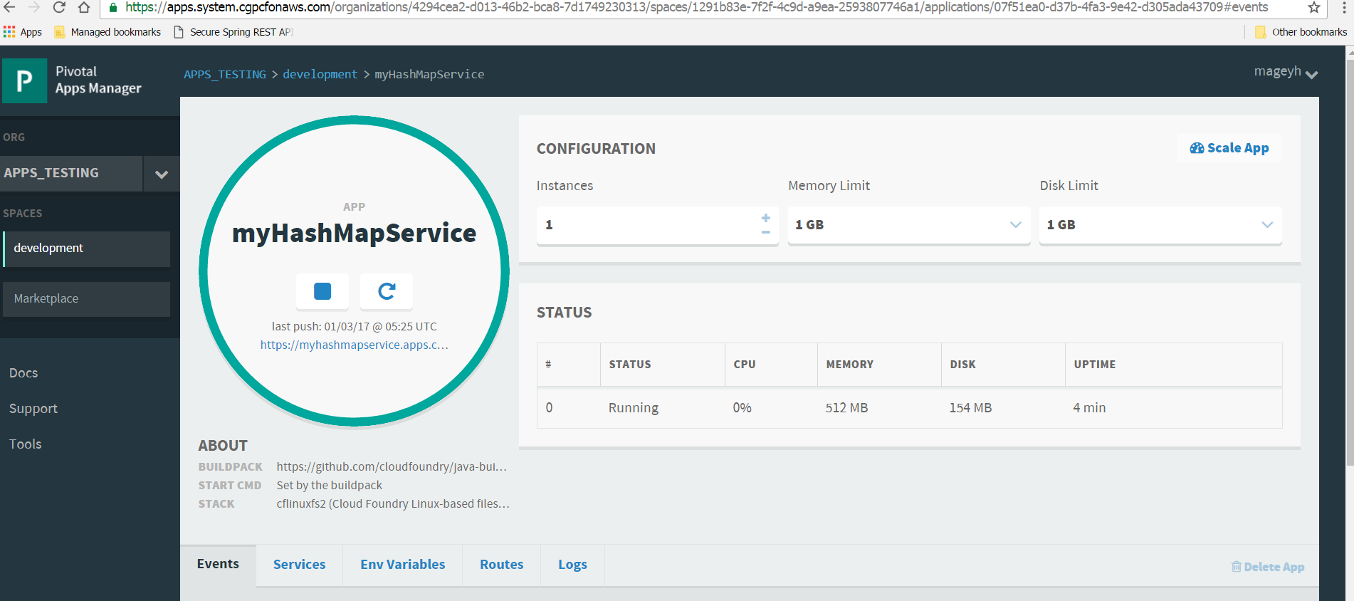
App Deployment
Console view after deployment
Notes:
Before you can push your app to Cloud Foundry you need to know:
The API endpoint for your Cloud Foundry instance. Also known as the target URL, this is the URL of the Cloud Controller in your Cloud Foundry instance.
Your username and password for your Cloud Foundry instance.
The organization and space where you want to deploy your app. A Cloud Foundry workspace is organized into organizations, and within them, spaces. As a Cloud Foundry user, you have access to one or more organizations and spaces.

Slide 18
App Deployment
Restart Your Application
Restarting your application stops your application and restarts it with the already compiled droplet. A droplet is a tarball that includes:
stack
buildpack
application source code
cf restart <YOUR-APP>
Restart your application to refresh the application’s environment after actions such as binding a new service to the application or setting an environment variable that only the application consumes.
Restage Your Application
Restaging your application stops your application and restages it, by compiling a new droplet and starting it.
cf restage< YOUR-APP>
Restage your application if you have changed the environment in a way that affects your staging process, such as setting an environment variable that the buildpack consumes.
Restaging your application compiles a new droplet from your application without updating your application source. If you need to update your application source, re-push your application

Slide 19
App Deployment
Configure Pre-Runtime Hook
Java build pack does not support pre-runtime hooks.
To configure pre-runtime hooks, create a file named .profile and place it in the root of your app directory. If the directory includes a .profile script, then Cloud Foundry executes it immediately before each instance of your app starts.
You can use the .profile script to perform app-specific initialization tasks, such as setting custom environment variables. Environment variables are key-value pairs.
To set an environment variable, add the appropriate bash commands to your .profile file. See the example below.
# Set the default LANG for your apps
export LANG=en_US.UTF-8
Notes:
Note: Your app root directory may also include a .profile.d directory that contains bash scripts that perform initialization tasks for the buildpack. Developers should not edit these scripts unless they are using a custom buildpack.

Slide 20
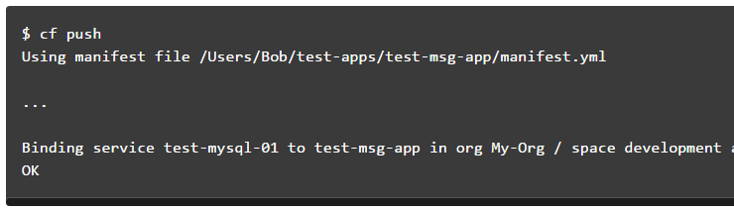
App Deployment
Push through Manifest

Slide 21
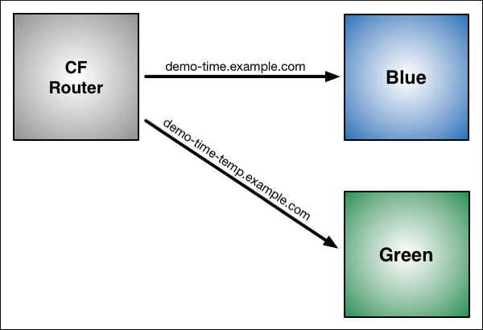
Blue-Green Deployment
Blue-green deployment is a release technique that reduces downtime and risk by running two identical production environments called Blue and Green.
At any time, only one of the environments is live, with the live environment serving all production traffic. For this example, Blue is currently live and Green is idle.
Notes:
Notes:
If your app uses a relational database, blue-green deployment can lead to discrepancies between your Green and Blue databases during an update. To maximize data integrity, configure a single database for backward and forward compatibility.
You can adjust the route mapping pattern to display a static maintenance page during a maintenance window for time-consuming tasks, such as migrating a database. In this scenario, the router switches all incoming requests from Blue to Maintenance to Green.

Slide 22
Scaling an Application
Factors such as user load, or the number and nature of tasks performed by an application, can change the disk space and memory the application uses. For many applications, increasing the available disk space or memory can improve overall performance
Scaling :
Running additional instances of an application can allow the application to handle increases in user load and concurrent requests..
Scaling Horizontally
cf scale myApp -i 5
Scaling Vertically
cf scale myApp -k 512M
cf scale myApp -m 1G

Slide 23
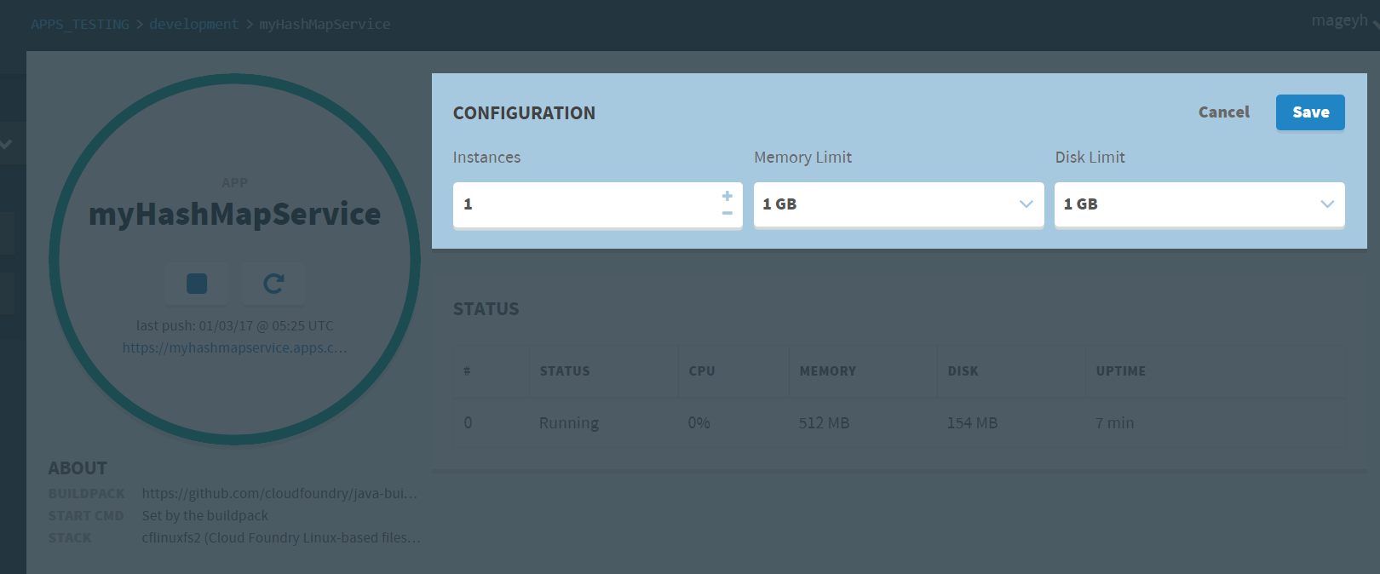
Scaling an Application
Configure Autoscaling for an App
Autoscaler keeps instance counts within an allowable range defined by minimum and maximum values, or instance limits.
Instance Limits
Scaling Rules
Scheduled Limit Changes

Slide 24
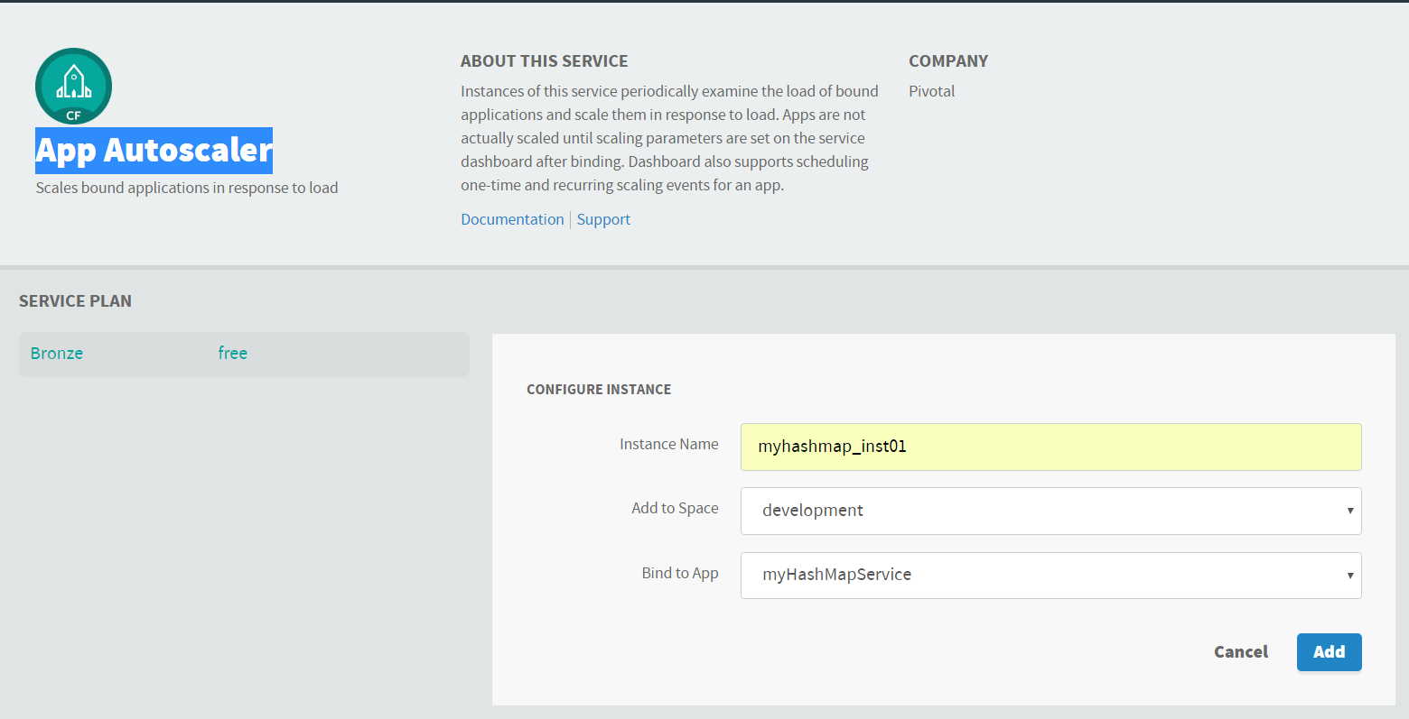
Scaling an Application
Configure Autoscaling for an App
Creating Autoscalar instance and binding to an App

Slide 25
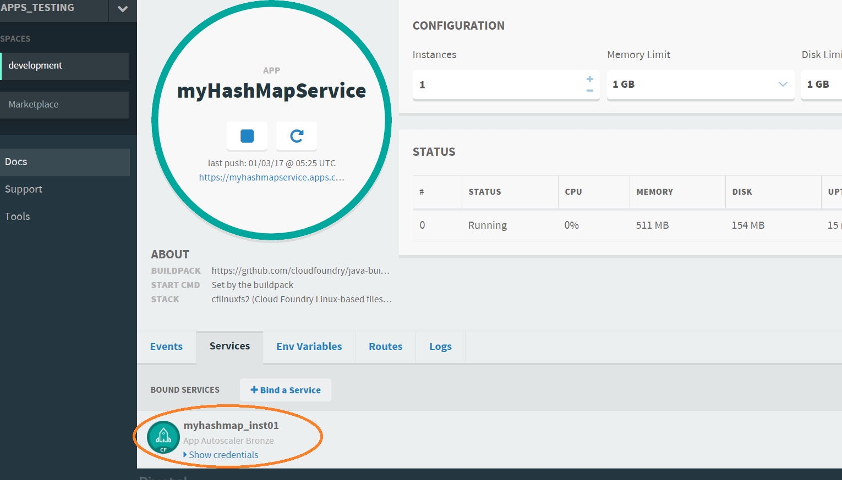
Scaling an Application
Configuring Autoscaler instance to an App

Slide 26
Services
For end users of Cloud Foundry they can do provisioning of service instances and integrating them with applications that have been pushed to Cloud Foundry.
Services and Service Instances
Cloud Foundry offers a marketplace of services, from which users can provision reserved resources on-demand.
E.g. resources services provide include databases on a shared or dedicated server, or accounts on a SaaS application.
These resources are known as service instances and the systems that deliver and operate these resources are known as Services.
User-Provided Service Instances
Cloud Foundry enables users to leverage services that are not available in the marketplace using a feature called User-Provided Service Instances (UPSI).
User-Provided Service Instances
Use (alias cf cups) creates a new service instance.
E.g. cf cups sql-service-instance -p "host, port, dbname, username, password“
To create a service instance that sends data to a third-party.
Use the -l option followed by the external destination URL.
E.g. cf cups mylog -l syslog://logs4.example.com:25258
Use (alias cf uups) to update a existing service instance.
E.g. cf uups sql-service-instance -p "host, port, dbname, username, password“
Service Instance Credentials
If your app need to bind or use any service instance, then user must use the credentials provided by CF.
For external and local clients, you can use service keys to generate credentials to communicate directly with a service instance
Notes:
For a service to be available in the marketplace, it must be integrated with Cloud Foundry by way of APIs.

Slide 27
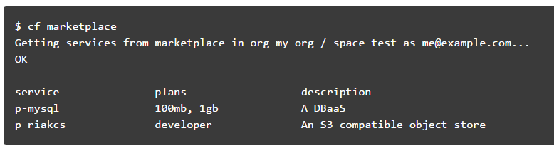
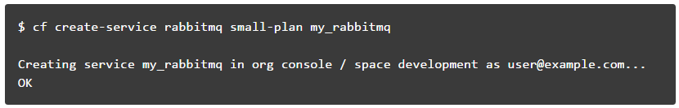
Manage Service Instances with the CLI
List Marketplace Services
Creating Service Instances
create a service instance with the command;
cf create-service <SERVICE> <PLAN> <SERVICE_INSTANCE>
Notes:
For a service to be available in the marketplace, it must be integrated with Cloud Foundry by way of APIs.

Slide 28
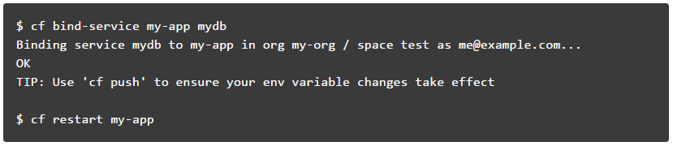
Manage Service Instances with the CLI
Bind a Service Instance
binding a service instance to an application after pushing an application
Binding a service with Application Manifest
Alternatively, a service instance can be bind to an app after pushing an application, you can use the application manifest to bind the service instance during push
Manifest.yml
services:
- test-mysql-01

Slide 29
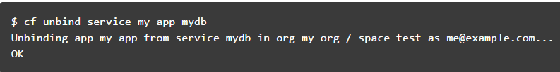
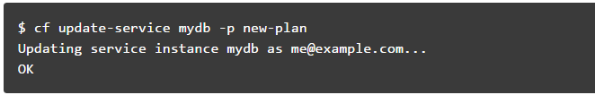
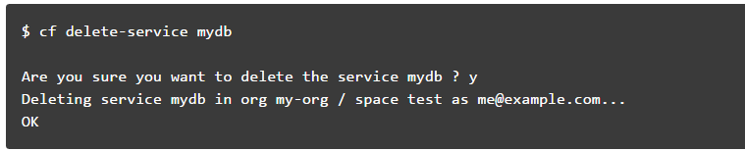
Manage Service Instances with the CLI
Unbind a Service Instance
Unbinding a service instance from an application removes the credentials created for your application from the VCAP_SERVICES environment variable.
Update a Service Instance
If any service plan needs to be updated to your service instance, then cf update-service can be performed,
Delete a service Instance
Notes:
Note: You must restart or in some cases re-push your application for changes to be applied to the VCAP_SERVICES environment variable and for the application to recognize these changes.

Slide 30
Buildpack
Buildpacks provide framework and runtime support for your applications.
Buildpacks typically examine user-provided artifacts to determine what dependencies to download and how to configure applications to communicate with bound services.
When you push an application, Cloud Foundry automatically detects which buildpack is required and installs it on the Diego cell where the application runs.
During staging, each buildpack has a position in a priority list (identified by running cf buildpacks).
Cloud Foundry checks if the buildpack in position 1 is a compatible buildpack. If the position 1 buildpack is not compatible, Cloud Foundry moves on to the buildpack in position 2. Cloud Foundry continues this process until the correct buildpack is found. If no buildpack is compatible cf push fails.

Slide 31
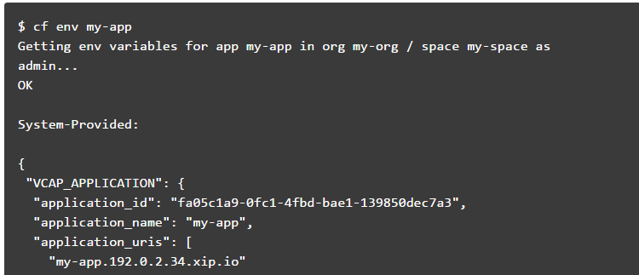
Cloud Foundry Environment Variables
Environment variables are the means by which the Cloud Foundry runtime communicates with a deployed application about its environment.
View Environment Variables

Slide 32
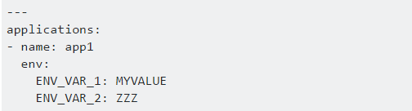
Cloud Foundry Environment Variables
Setting env variable via CF CLI
E.g.
cf set-env APP_NAME ENV_VAR_NAME ENV_VAR_VALUE
Reverting the env variable
E.g.
cf unset-env APP_NAME ENV_VAR_NAME
In addition, you can set environment variables in an application manifest file.

Slide 33
Cloud Foundry Environment Variables
VCAP_SERVICES
The VCAP_SERVICES environment variable is a JSON object that contains information that you can use to interact with a service instance
The information includes service instance name, credential, and connection URL to the service instance. These values are populated into the VCAP_SERVICES environment variable when your application is bound to a service instance.
The value of the VCAP_SERVICES environment variable is available only when you bind a service instance to your application.
The service object contains a child object for each service instance of that service that is bound to the application.

Slide 34
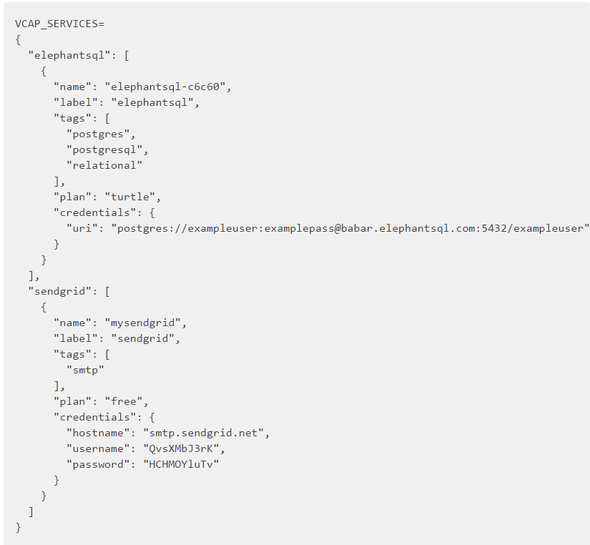
Cloud Foundry Environment Variables
VCAP_SERVICES
The example below shows the value of VCAP_SERVICES for bound instances of several services available in the Pivotal Web Services Marketplace.

Slide 35
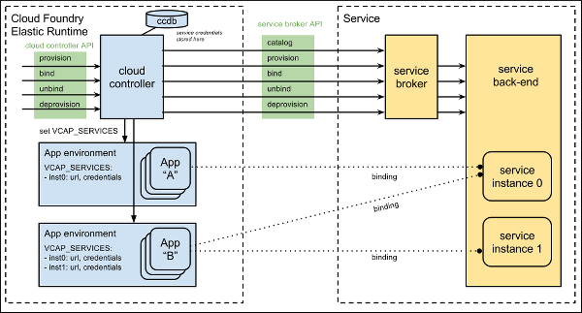
Service Broker

Slide 36
Service Broker
Services are integrated with Cloud Foundry by implementing a documented API for which the cloud controller is the client; we call this the Service Broker API.
Service Broker is the term we use to refer to a component of the service which implements the service broker API.
Service brokers advertise a catalog of service offerings and service plans, as well as interpreting calls for provision (create), bind, unbind, and deprovision (delete).

Slide 37
Service Broker
Implementation & Deployment
Cloud Foundry only requires that the service provider implement the service broker API. A broker can be implemented as a separate application, or by adding the required http endpoints to an existing service.
Because Cloud Foundry only requires that a service implements the broker API in order to be available to Cloud Foundry end users.
examples of valid deployment models.
Entire service packaged and deployed by BOSH alongside Cloud Foundry
Broker packaged and deployed by BOSH alongside Cloud Foundry, rest of the service deployed and maintained by other means
Broker (and optionally service) pushed as an application to Cloud Foundry user space
Entire service, including broker, deployed and maintained outside of Cloud Foundry by other means

Slide 38
Service Broker
Managing Service Brokers
Steps make its services available to end users in all orgs or a limited number of orgs by service plan.
Register a Broker
Publish service plans to specific orgs or all orgs in the deployment. Can also keep plans unavailable, or private.
Created by admins, with the command
cf create-service-broker$ cf create-service-broker mybrokername someuser somethingsecure http://mybroker.example.com/
Managed by admins
Service plans are created private. Before anyone can use them, an admin must explicitly make them available within an org or across all orgs.
Make Plans Public
After an admin creates a new service plan from a standard broker, no one can use it until the admin explicitly makes it available to users within a specific org or all orgs in the deployment.

Slide 39
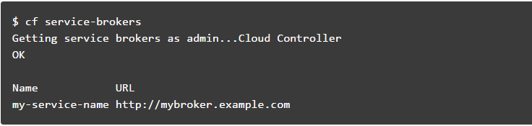
Service Broker
List Service Brokers
Update a Broker
Remove a Broker

Slide 40
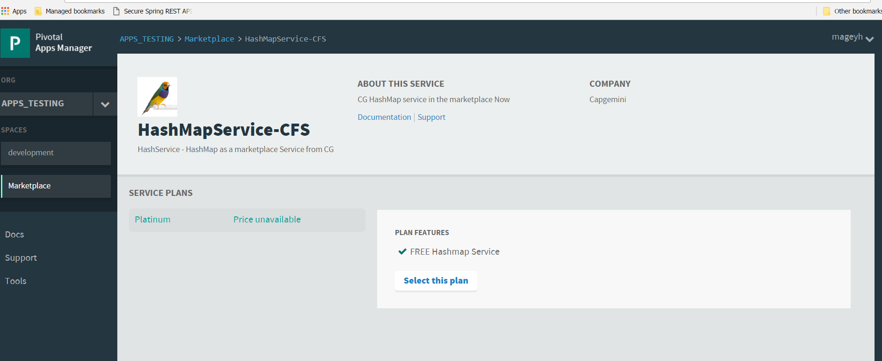
Service Broker
Creating Custom service and making it available in the Marketplace.

